Slide 1

Transaction Labelling Service Architecture
Objective: Develop a service to automatically and accurately label transactions using data provided my pre-existing transaction processor API for Chorus

Slide 2

Project Background – Context and Data Source
Context: Automated transaction labelling to improve financial data analysis, budgeting and user insights.
Data Source: Pre-existing transaction processor API and transaction records from Chorus with fields like Transaction ID, accounts, bank codes, amount and narration

Slide 3
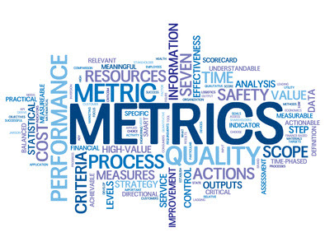
Requirements and Goal – Primary Requirement and Key Metrics
Primary Requirement: Classify transaction accurately incorporating a feedback loop to enhance classification over time.
Key Metrics: Target high initial accuracy, scalable performance and real-time response for optimal user experience.
This Photo by Unknown Author is licensed under CC BY-SA

Slide 4

Data Structure Enhancement for Improved Accuracy – Additional Data Fields for Labelling
Transaction Metadata: Timestamp, location data, and currency code to increase context-based labelling accuracy.
Enhanced Narration Processing: Use NLP and Named Entity Recognition(NER) to extract key terms and entities from narration.

Slide 5
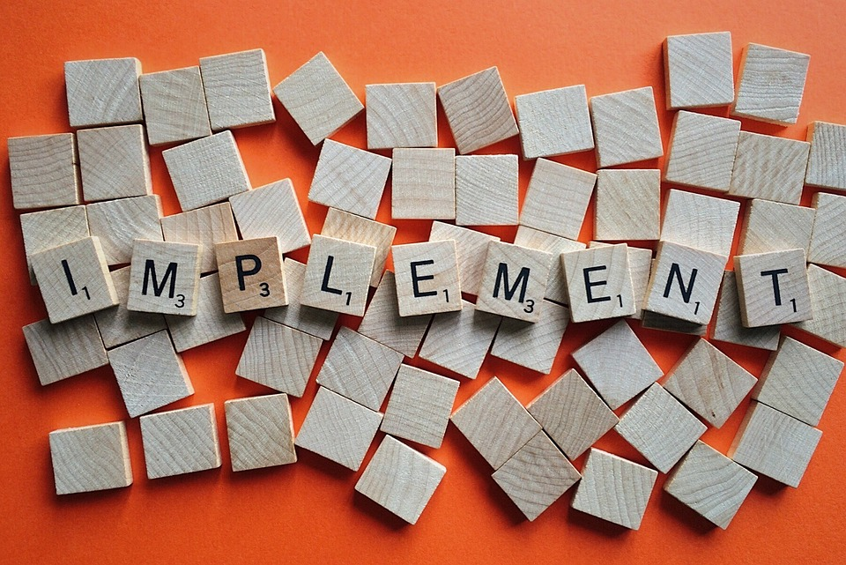
Implementation Plan – Roadmap for Development
Data Collection and Processing: At this stage, we have a few options, we could push transaction records as soon as they are processed and stored in the database to Apache Kafka. We could also normalize the data by adding more fields that will improve the accuracy of the model
Baseline Model Training: At this stage, we perform preliminary model training using basic categorization technique and ML models. We can begin training with models like Naïve Bayes and Decision Trees, then consider advanced models like Transformers

Slide 6
Implementation Plan Cont’d – Roadmap for Development
Model Refinement with Feedback: Because we want to achieve a high accuracy, this is the stage where we will incorporate user feedback to improve model performance. This will be done iteratively over a specified interval
Scalable Deployment: At this stage, we deploy the model on a scalable architecture with caching for high frequency transactions

Slide 7
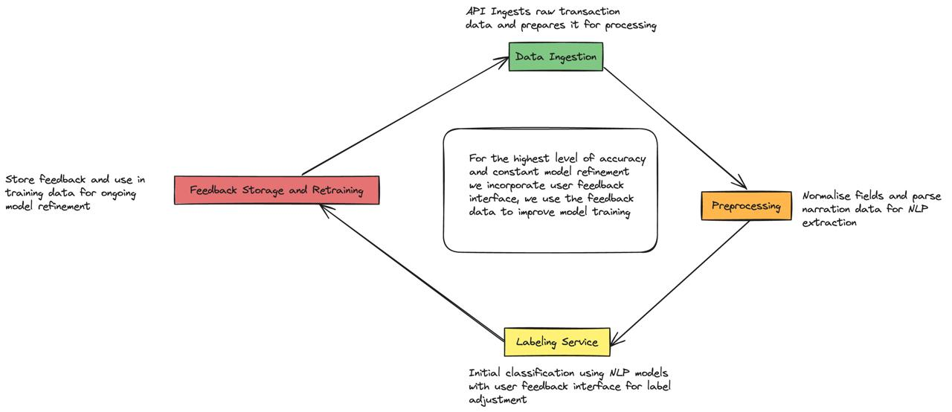
Data Ingestion, Processing and Labelling

Slide 8

Backend Architecture & Data Schema – Database & System Components
Data Schema:
Transaction Table: includes fields like transactionId, amount, accounts, narration, timestamp, location, label etc.
Feedback Table: Track user feedback with fields like feedbackId, transactionId, originalLabel, correctedLabel and timestamp
System Components:
Apache Kafka for asynchronous data processing and near-realtime data processing and response
API Gateway for data ingestion, ML Service for Labelling, Feedback and Re-training Pipeline for accuracy improvement.

Slide 9

Metrics & Evaluation Criteria – Key Indicators of Success
Accuracy and Precision: Regularly measure model labelling accuracy and precision to ensure high-quality classification
Scalability: Assess the model, kafka and database performance transaction volume grows
Feedback Utilization Rate: Track the rate of feedback incorporated into retraining cycles for continuous improvement

Slide 10

Implementation Consideration for Optimal Performance – Scalability and Performance Optimization
Data Volume Management: Plan for growing data through efficient indexing and database partitioning
Model Serving: Utilize lightweight models or cloud-based ML services for low latency responses
Feedback Automation: Automate retraining with MLOps to continually improve based on user feedback

Slide 11



Conclusion – Summary and Key Takeaway
Summary of Roadmap
A structured step-by-step
Approach focused on accuracy, scalability and continuous improvement through feedback
Scalability and Adaptability
The service architecture supports growth, with model retraining to adapt to evolving transaction pattern
Performance Optimization
Emphasis on caching and feedback-driven updates to ensure robustness

